Slide 1


(Computer Engineering and Technology) (SYB.Tech)
Subject : Data Engineering Techniques
Flagship University of MIT Group of Institutions
MIT-WPU is recognized by UGC and Approved by AICTE
M. Tech. (Computer Science & Engineering)
Notes:
© Copyright Showeet.com – Free PowerPoint Templates

Slide 2
Lab Assignment No 5 Association Rule Mining Using Apriori Algorithm
Subject : Data Engineering Techniques
Flagship University of MIT Group of Institutions
MIT-WPU is recognized by UGC and Approved by AICTE
M. Tech. (Computer Science & Engineering)
Notes:
© Copyright Showeet.com – Free PowerPoint Templates

Slide 3
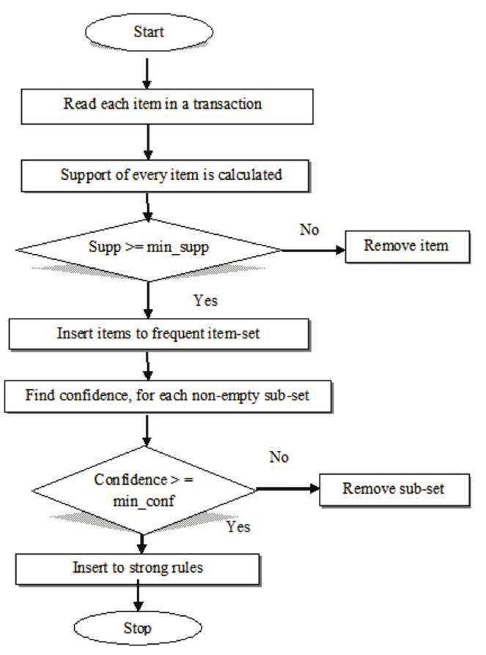
Apriori Algorithm Flowchart
15

Slide 4
Apriori Algorithm
Iterative algo. (also called level-wise search): Find all 1-item frequent itemsets; then all 2-item frequent itemsets, and so on.
In each iteration k, only consider itemsets that contain some k-1 frequent itemset.
Find frequent itemsets of size 1: F₁
From k = 2
C_{k} = candidates of size k: those itemsets of size k that could be frequent, given F_{k-1}
F_{k} = those itemsets that are actually frequent, F_{k} ⊆ C_{k} (need to scan the database once).

Slide 5
Example – Finding frequent itemsets
Dataset T
TID | Items
T100 | 1, 3, 4
T200 | 2, 3, 5
T300 | 1, 2, 3, 5
T400 | 2, 5
minsup=0.5
itemset:count
1. scan T ➔ C₁: {1}:2, {2}:3, {3}:3, {4}:1, {5}:3
➔ F₁: {1}:2, {2}:3, {3}:3, {5}:3
➔ C₂: {1,2}, {1,3}, {1,5}, {2,3}, {2,5}, {3,5}
2. scan T ➔ C₂: {1,2}:1, {1,3}:2, {1,5}:1, {2,3}:2, {2,5}:3, {3,5}:2
➔ F₂: {1,3}:2, {2,3}:2, {2,5}:3, {3,5}:2
➔ C₃: {2, 3,5}
3. scan T ➔ C₃: {2, 3, 5}:2 ➔ F_{3:} {2, 3, 5}

Slide 6
Apriori Algorithm
Algorithm Apriori(T)
C₁ ← init-pass(T);
F₁ ← {f | f ∈ C₁, f.count/n ≥ minsup}; // n: no. of transactions in T
for (k = 2; F_{k-1} ≠ ∅; k++) do
C_{k} ← candidate-gen(F_{k-1});
for each transaction t ∈ T do
for each candidate c ∈ C_{k} do
if c is contained in t then
c.count++;
end
end
F_{k} ← {c ∈ C_{k} | c.count/n ≥ minsup}
end
return F ← _{k} F_{k};

Slide 7
Apriori candidate generation
The candidate-gen function takes F_{k-1} and returns a superset (called the candidates) of the set of all frequent k-itemsets. It has two steps
join step: Generate all possible candidate itemsets C_{k} of length k
prune step: Remove those candidates in C_{k} that cannot be frequent.

Slide 8
Candidate-gen function
Function candidate-gen(F_{k-1})
C_{k} ← ∅;
forall f₁, f₂ ∈ F_{k-1}
with f₁ = {i₁, … , i_{k-2}, i_{k-1}}
and f₂ = {i₁, … , i_{k-2}, i’_{k-1}}
and i_{k-1} < i’_{k-1} do
c ← {i₁, …, i_{k-1}, i’_{k-1}}; // join f₁ and f₂
C_{k} ← C_{k} ∪ {c};
for each (k-1)-subset s of c do
if (s ∉ F_{k-1}) then
delete c from C_{k}; // prune
end
end
return C_{k};

Slide 9
An example
F₃ = {{1, 2, 3}, {1, 2, 4}, {1, 3, 4},
{1, 3, 5}, {2, 3, 4}}
After join
C₄ = {{1, 2, 3, 4}, {1, 3, 4, 5}}
After pruning:
C₄ = {{1, 2, 3, 4}}
because {1, 4, 5} is not in F₃ ({1, 3, 4, 5} is removed)

